Slide 1
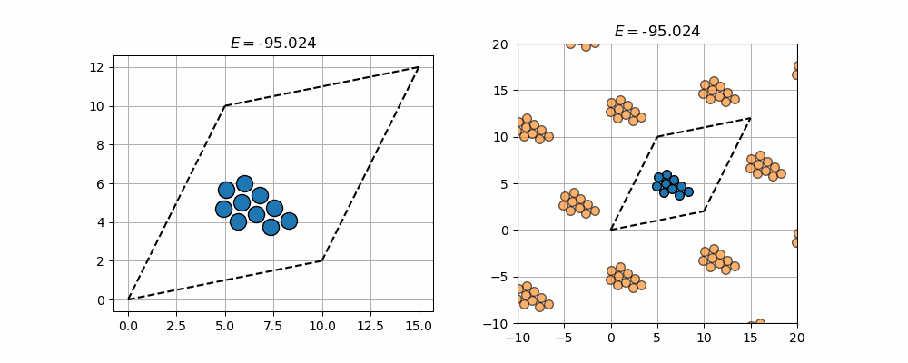
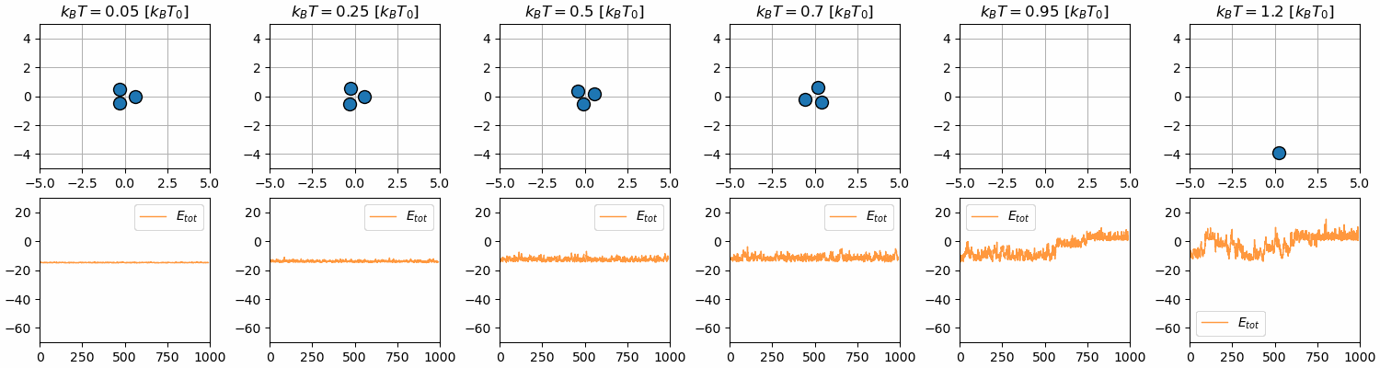
Simulation of phase transitions

Slide 2
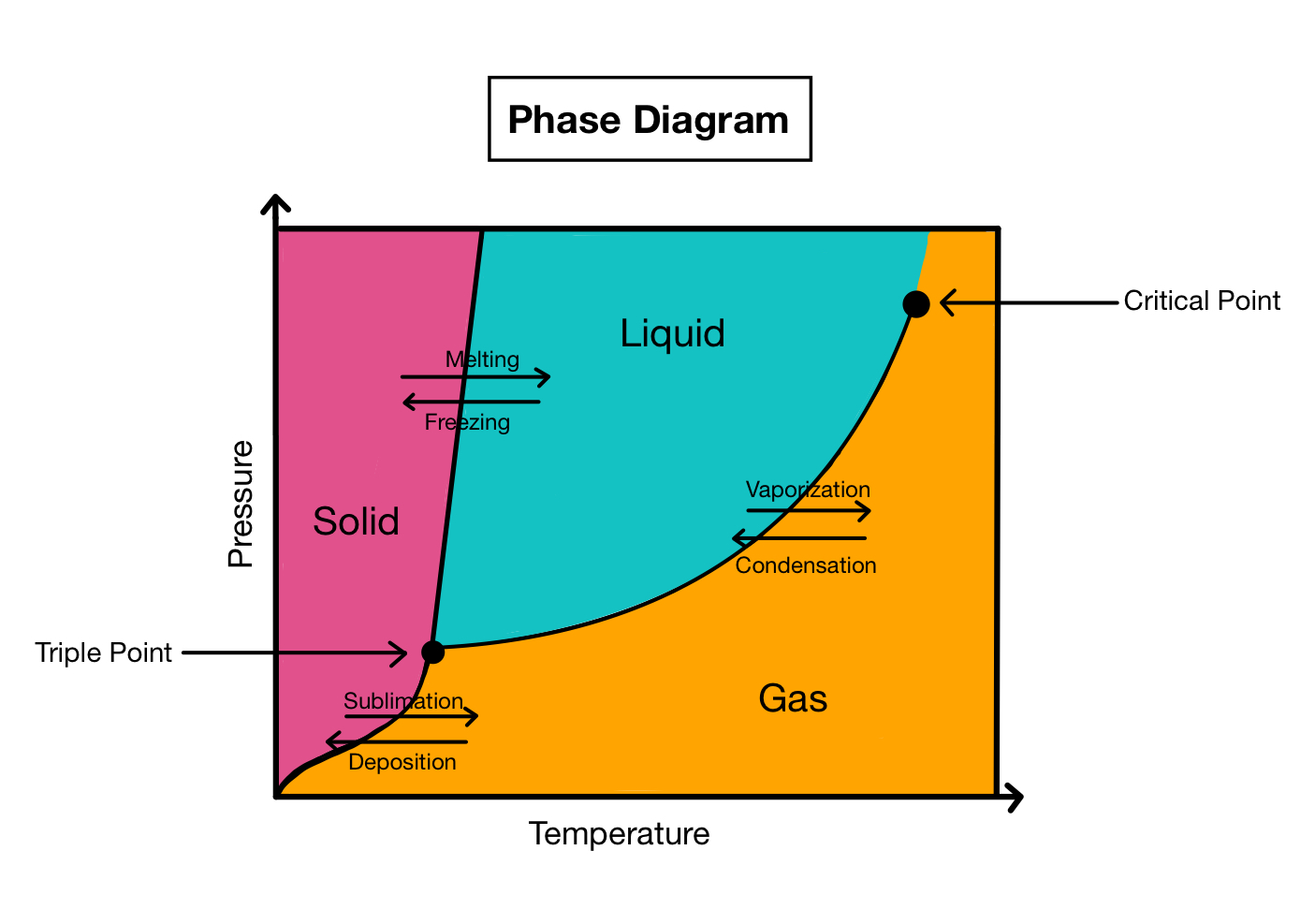
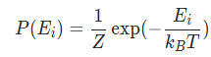
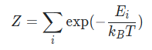
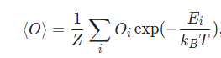
Introduction
Goal: Understand how to simulate phase transitions
What are these transitions?
Thermodynamic system → Canonical Ensemble
Need a notion of: T, V, P
Let’s get to work ☺

Slide 3
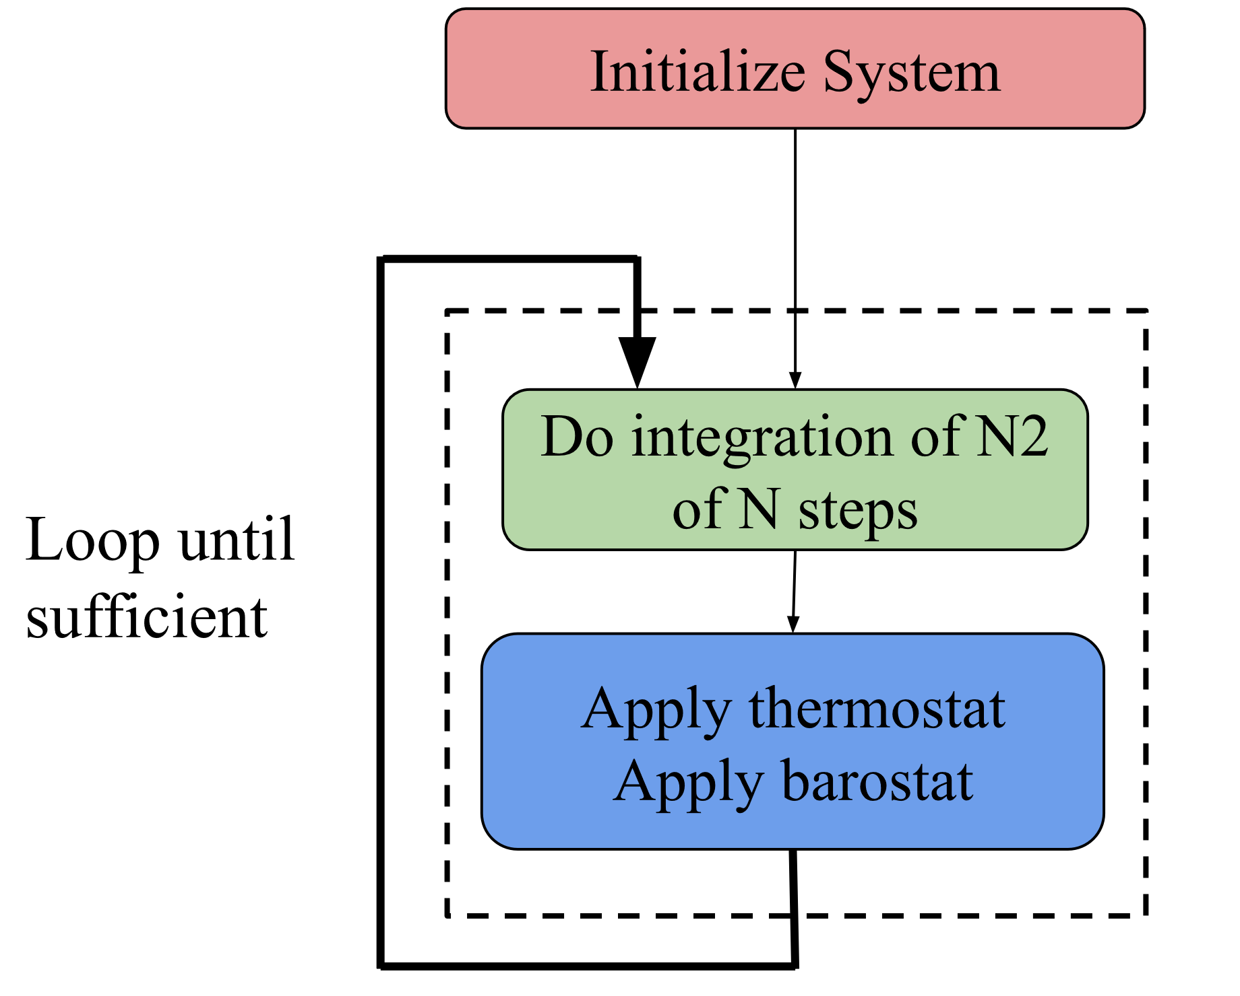
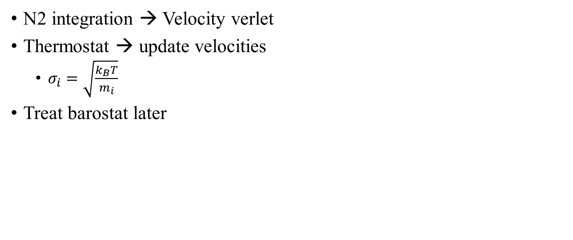
Molecular Dynamics (MD) – Simulations:
N2 integration → Velocity verlet
Thermostat → update velocities
$σ_{i}=\sqrt{\frac{k_{B}T}{m_{i}}}$
Treat barostat later

Slide 4
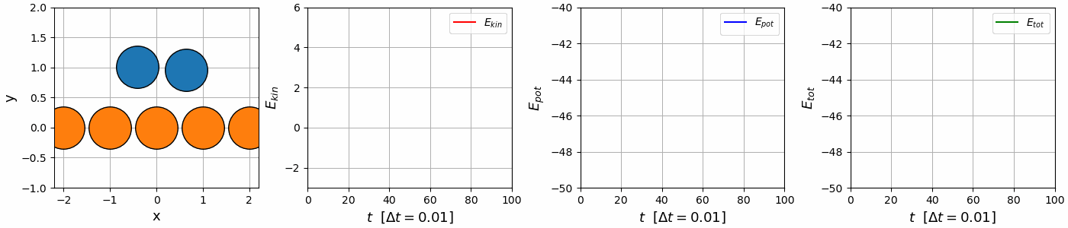
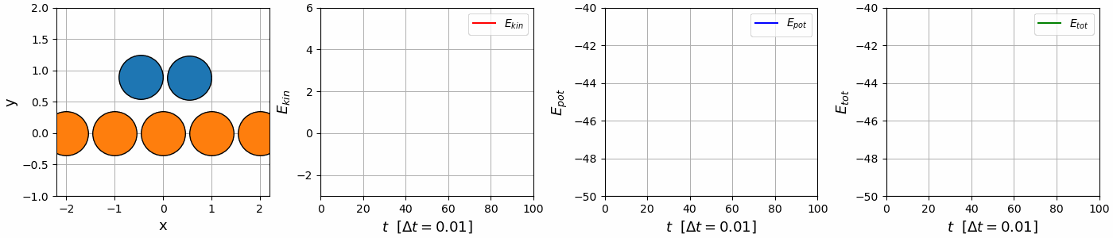
Velocity verlet vs. Euler integration
MD-simulations → Integration of N2 + thermostat
Velocity
verlet
Euler integration

Slide 5
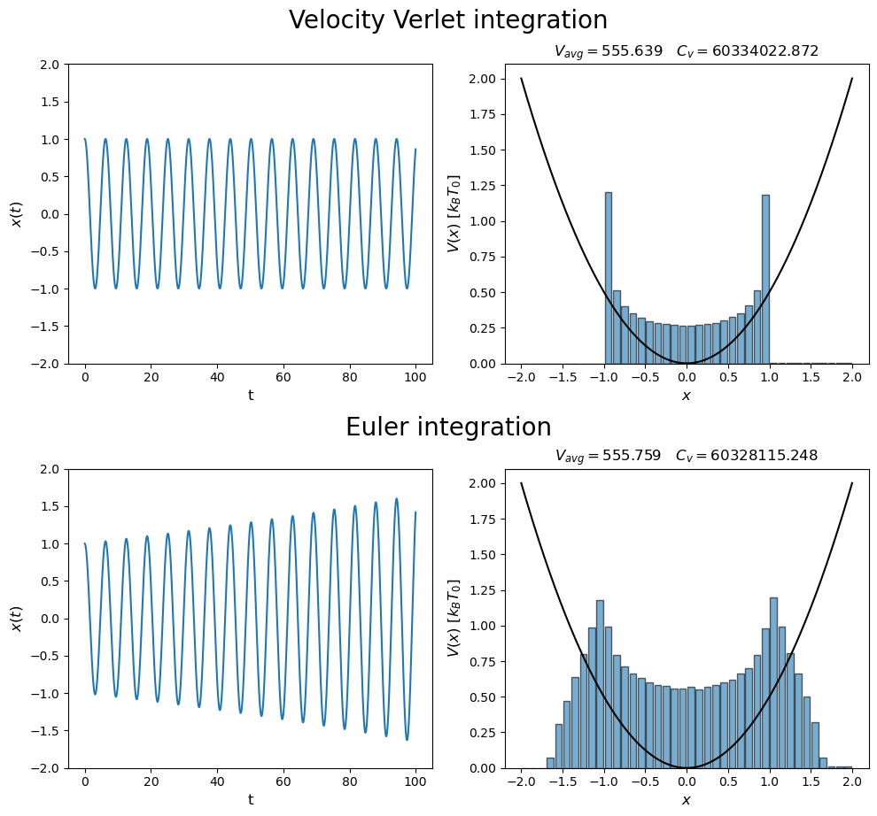
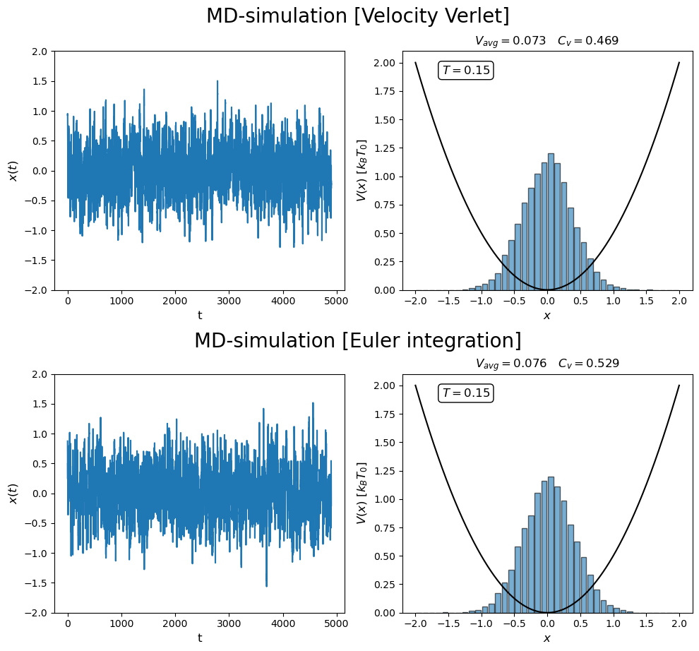
N2 integration + thermostat
Switch on thermostat

Slide 6
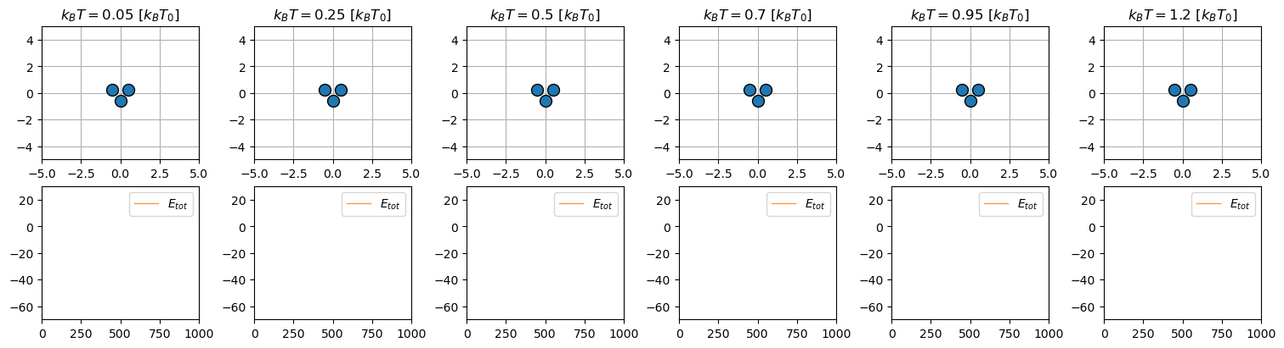
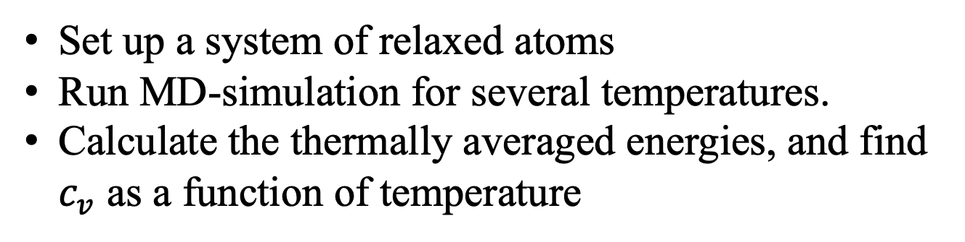
Find phase transition of simple molecule
Set up a system of relaxed atoms
Run MD-simulation for several temperatures.
Calculate the thermally averaged energies, and find $c_{v}$ as a function of temperature

Slide 7
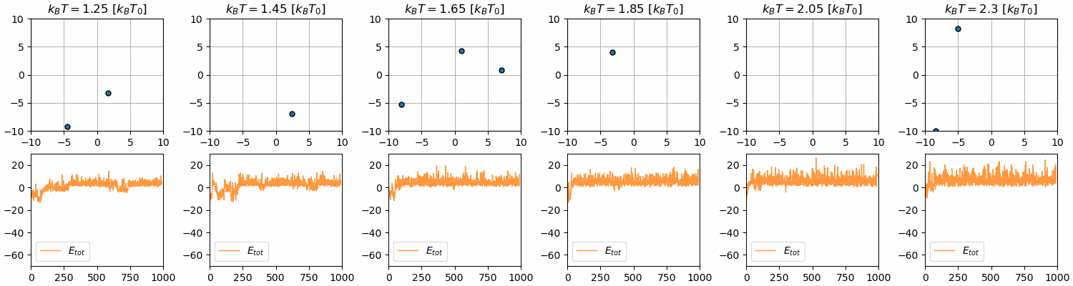
Find phase transition of simple molecule

Slide 8
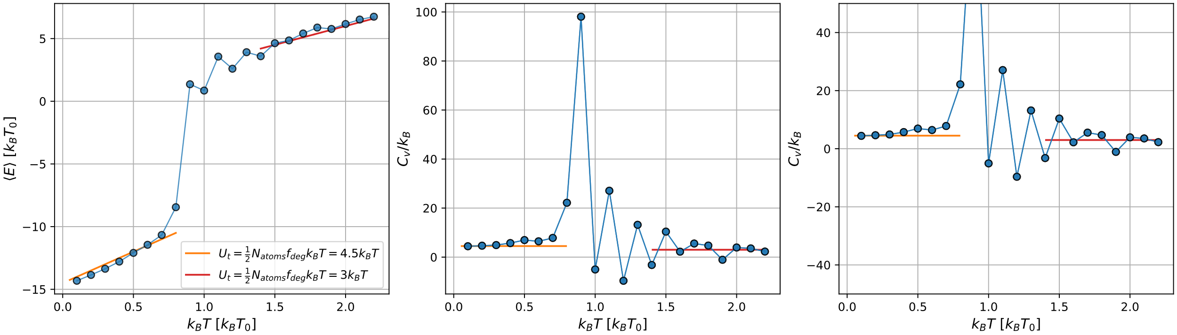
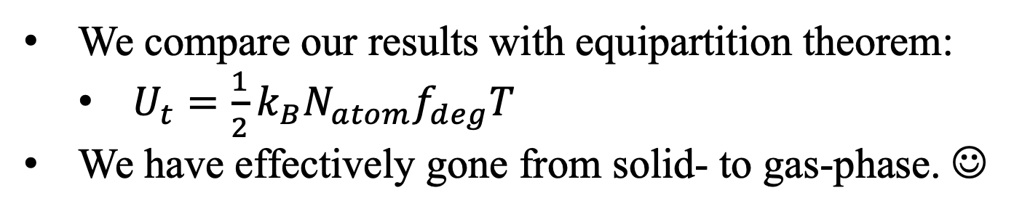
Find phase transition of simple molecule
We compare our results with equipartition theorem:
$U_{t}=\frac{1}{2}k_{B}N_{atom}f_{deg}T$
We have effectively gone from solid- to gas-phase. ☺

Slide 9
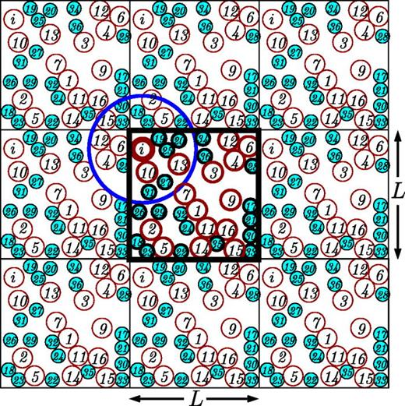
Methods for achieving phase transitions
Reversible effects?
What about pressure and volume?
No problem → finite simulation box + periodic boundary conditions (pbc)
Minimum image convention

Slide 10
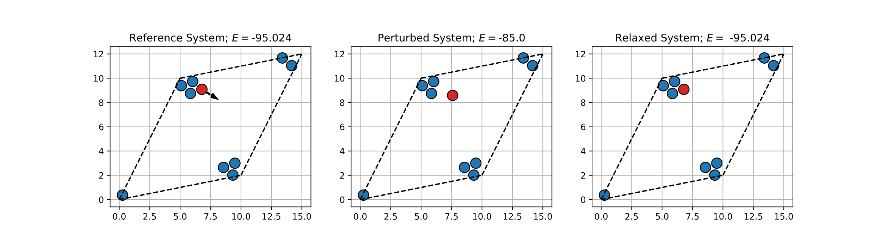
Implement minimum image convention

Slide 11
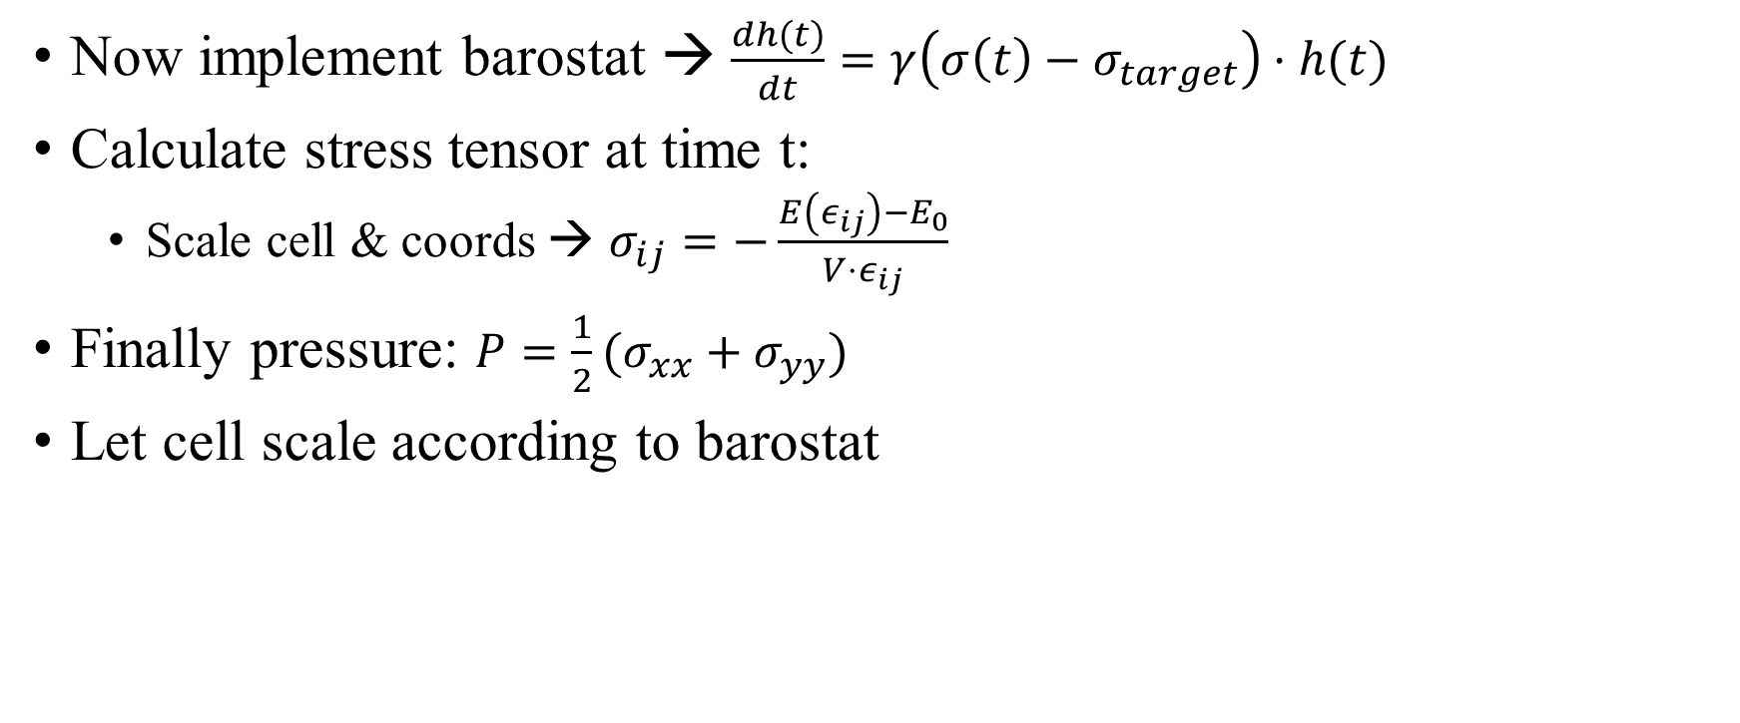
Implement barostat
Now implement barostat → $\frac{dh(t)}{dt}=γ\left(σ\left(t\right)−σ_{target}\right)⋅h(t)$
Calculate stress tensor at time t:
Scale cell & coords → $σ_{ij}=−\frac{E\left(ε_{ij}\right)−E_{0}}{V⋅ε_{ij}}$
Finally pressure: $P=\frac{1}{2}(σ_{xx}+σ_{yy})$
Let cell scale according to barostat

Slide 12
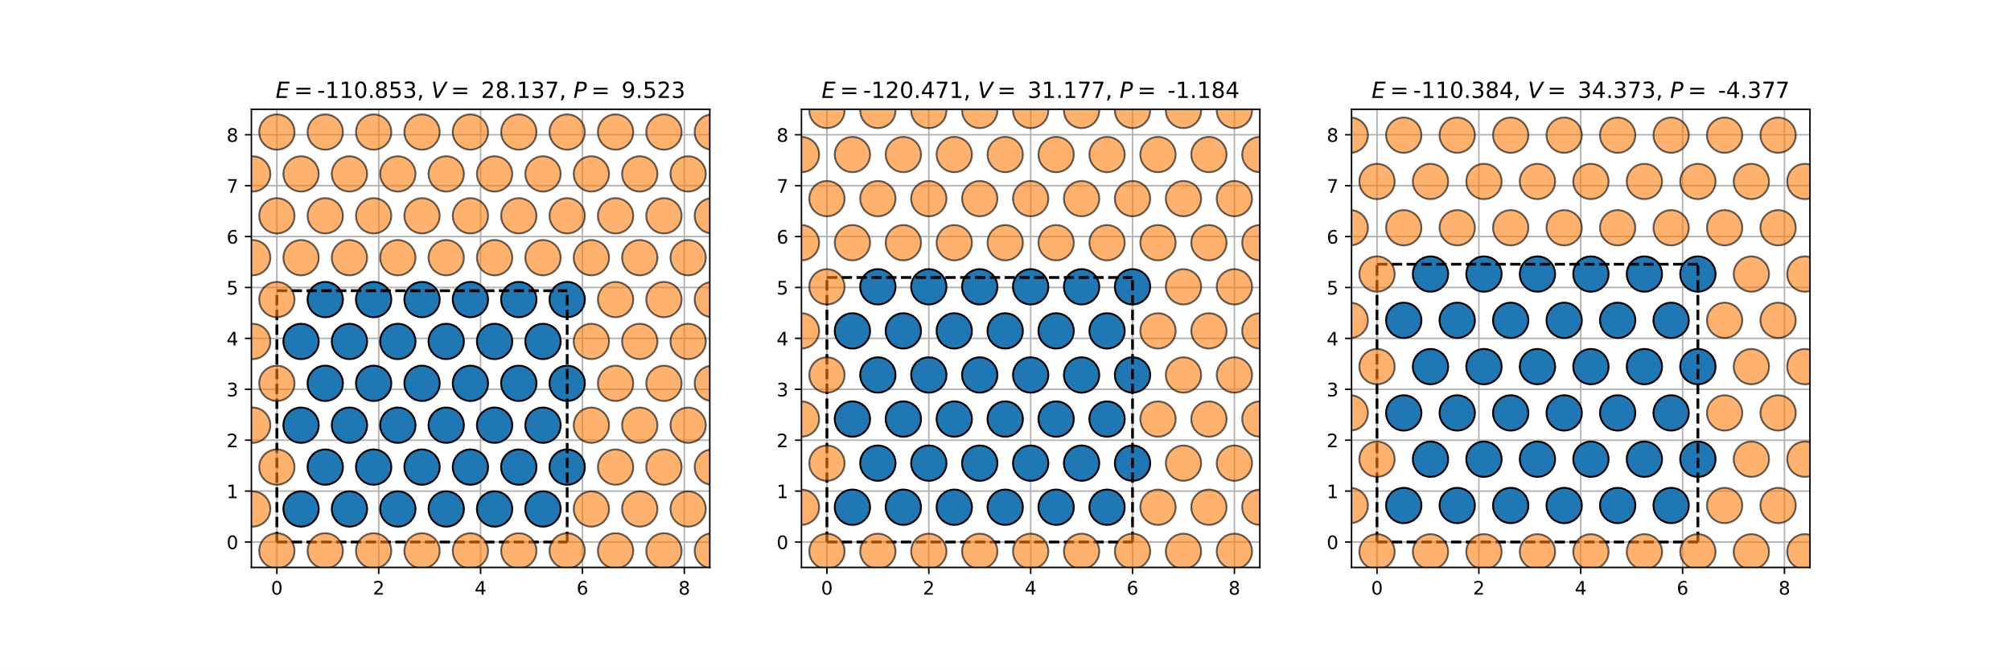
Implement & use
-5%
0%
+5%

Slide 13
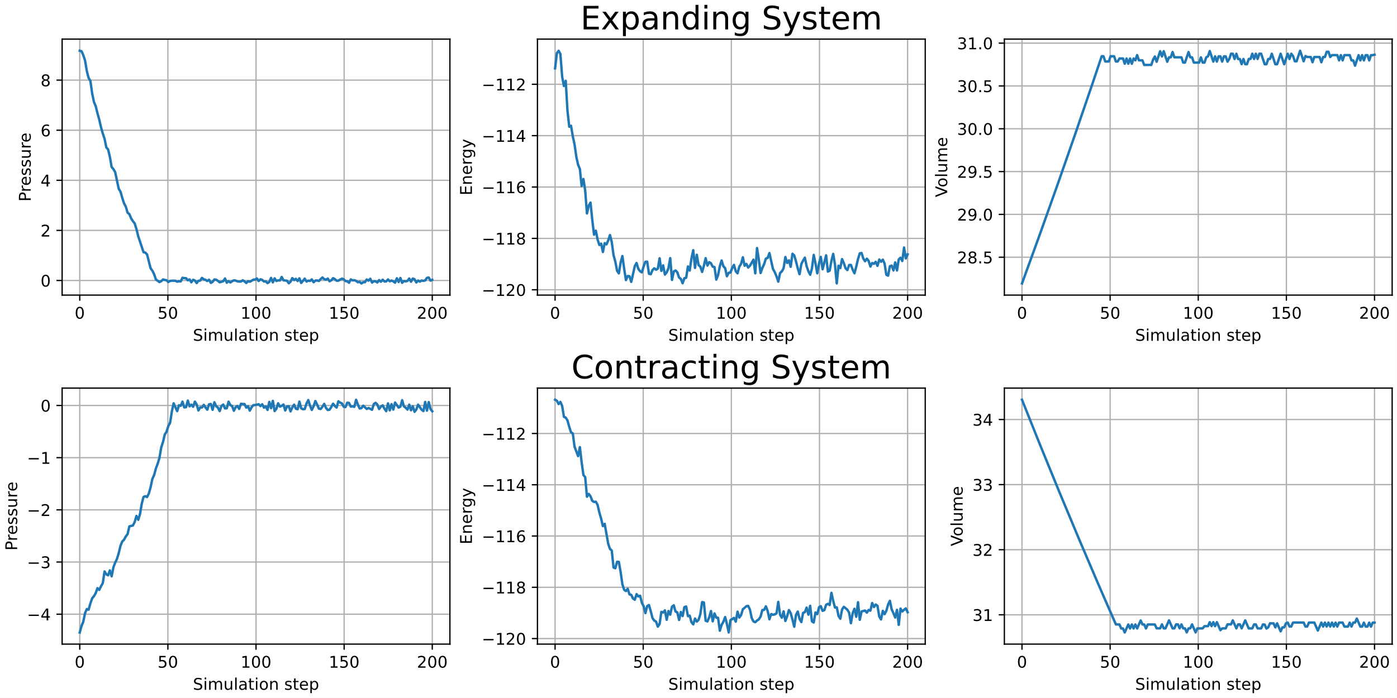
Implement & use

Slide 14
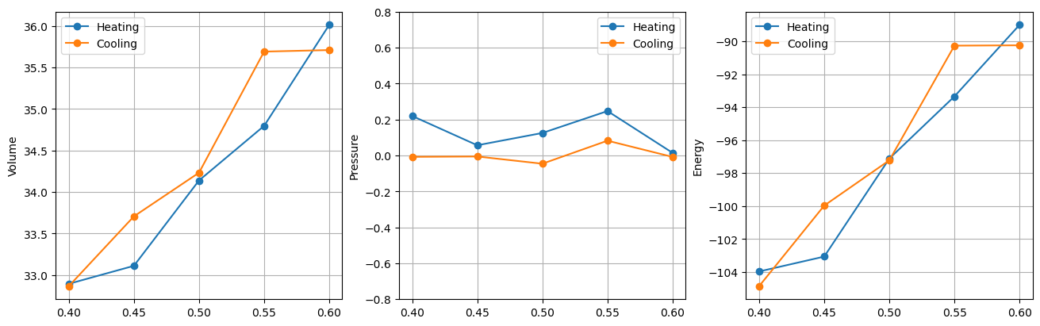
Implement & use
We heat up a system and subsequently let the pressure and volume equilibrate with 0 pressure.
Calculate average volumes, pressures and energies

Slide 15
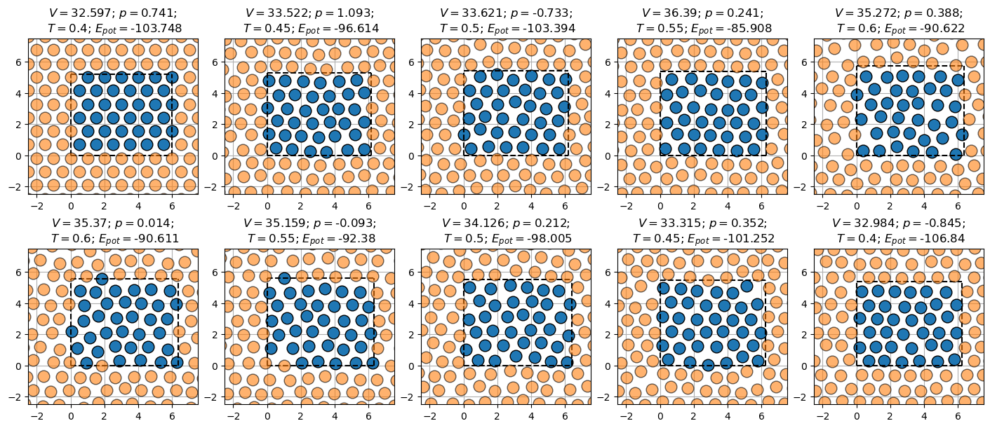
Implement & use

Slide 16
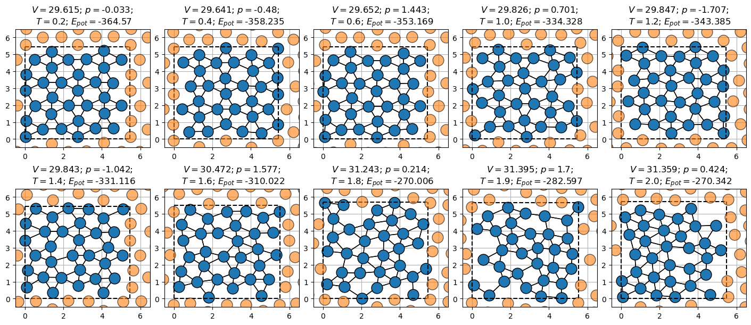
Heat-up phase

Slide 17
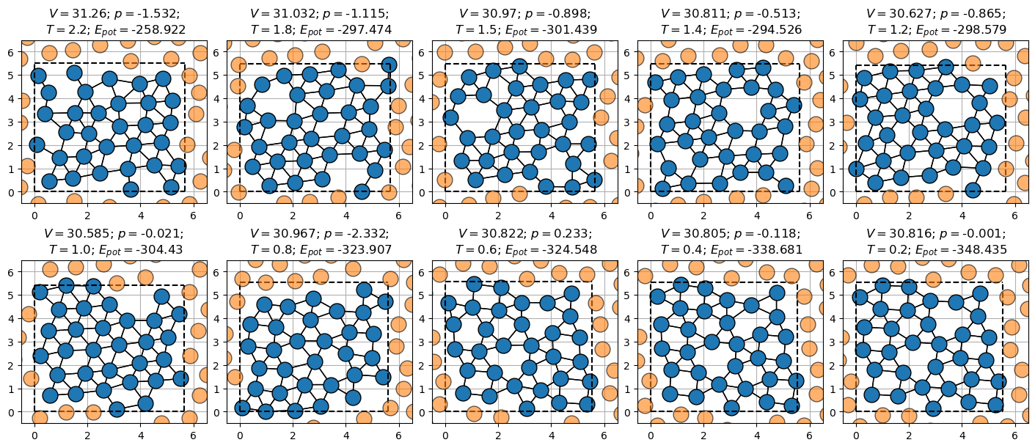
Cool-down phase

